Slide 1
Computational Cognitive Neuroscience Bootcamp
Randall C. O’Reilly
University of California Davis
eCortex, Inc, Astera Obelisk

Slide 2
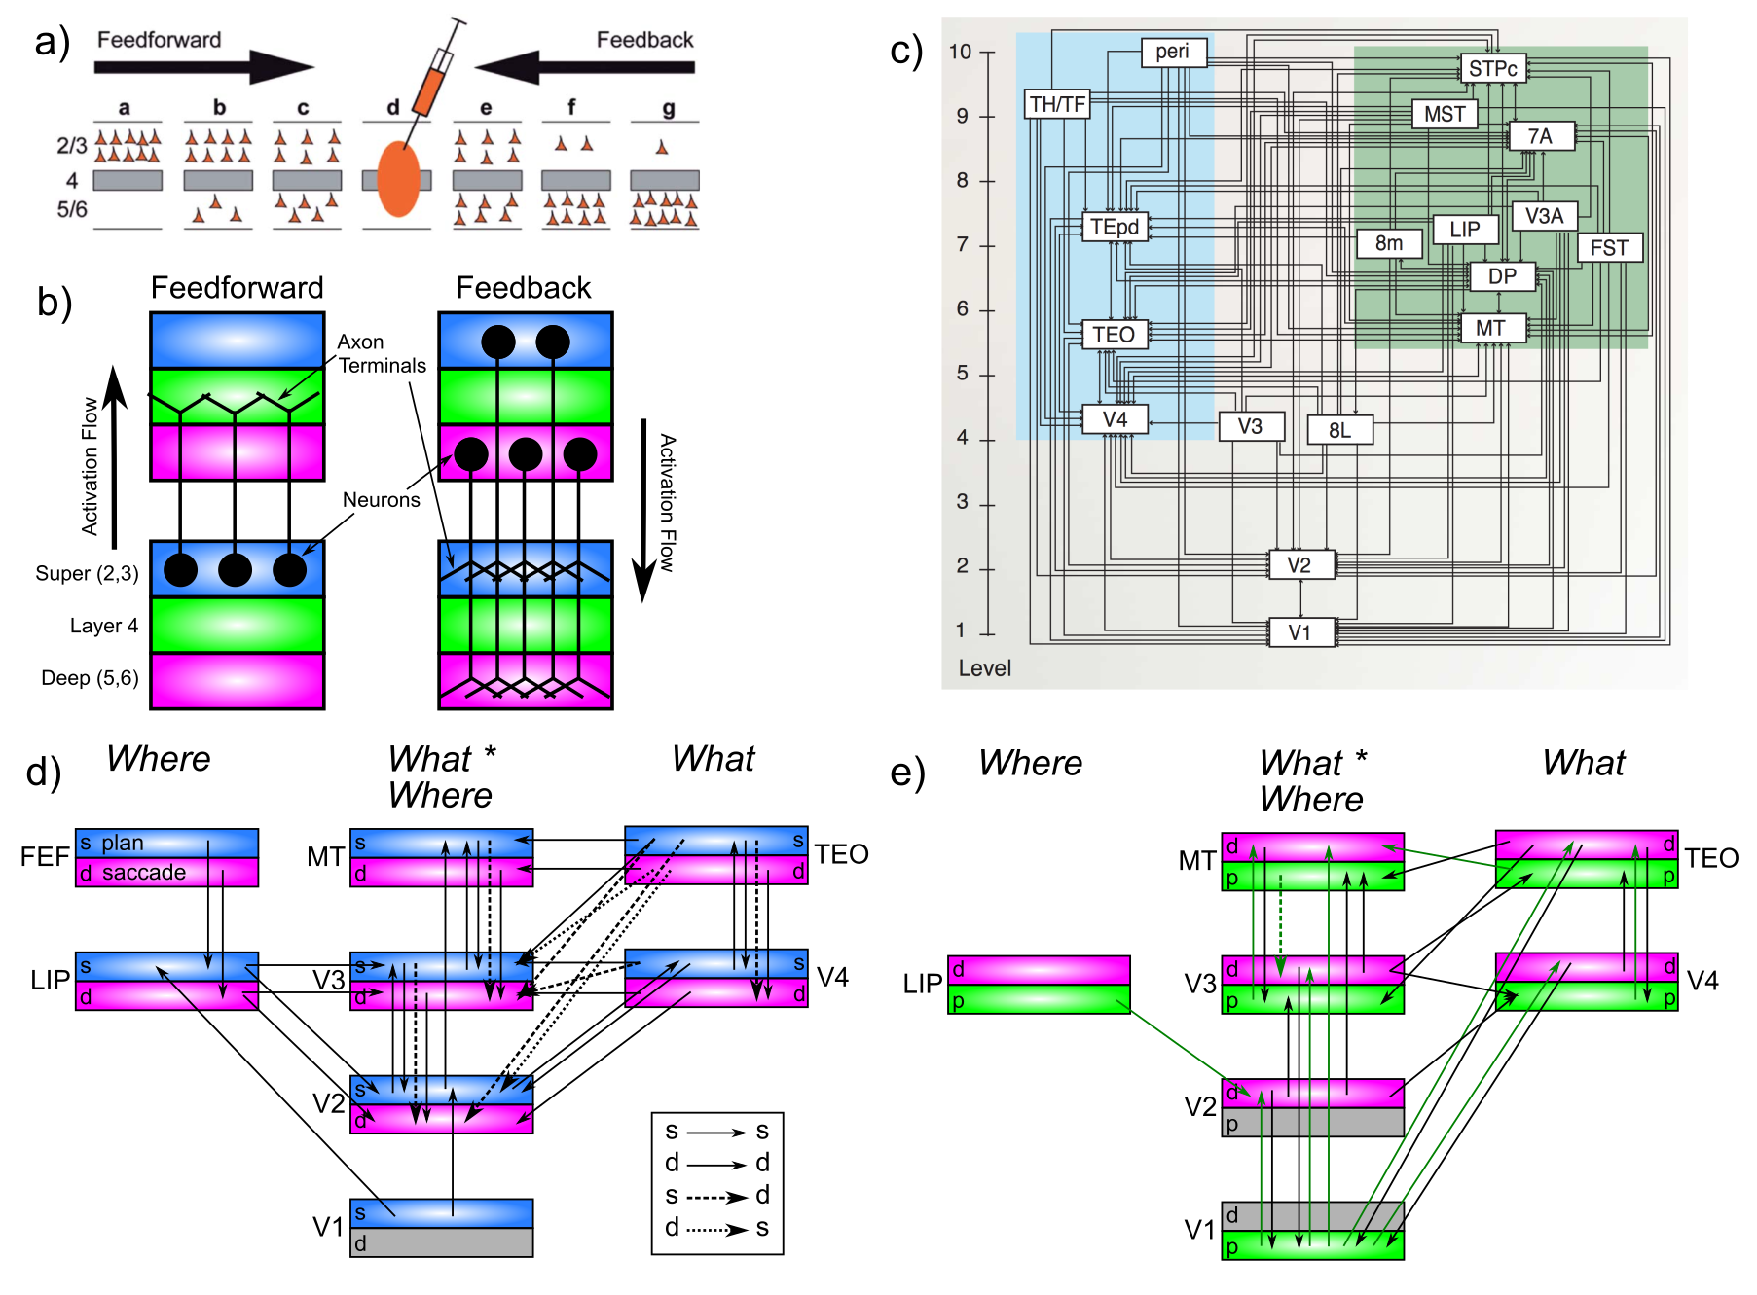
Computational Systems Neuro

Slide 3
Computational Neuroscience
Detailed models of individual neurons
Complexity of dendritic information processing
Mathematical analyses of networks
Stability of active maintenance as reverberations among interconnected neurons (Goldman)
How to prune connections without losing too much (Chaudhuri)
Information integration, Drift Diffusion Models (Hanks, Ditterich)

Slide 4
Computational Cognitive Neuro: https://CompCogNeuro.org
Perception: deep hierarchical object recognition
Attention: bidirectional excitation + inhibition
Memory: sparse representations in hippocampus
Language: regularities and exceptions; integration over time
Executive function: prefrontal cortex + basal ganglia: gating, working memory, control

Slide 5
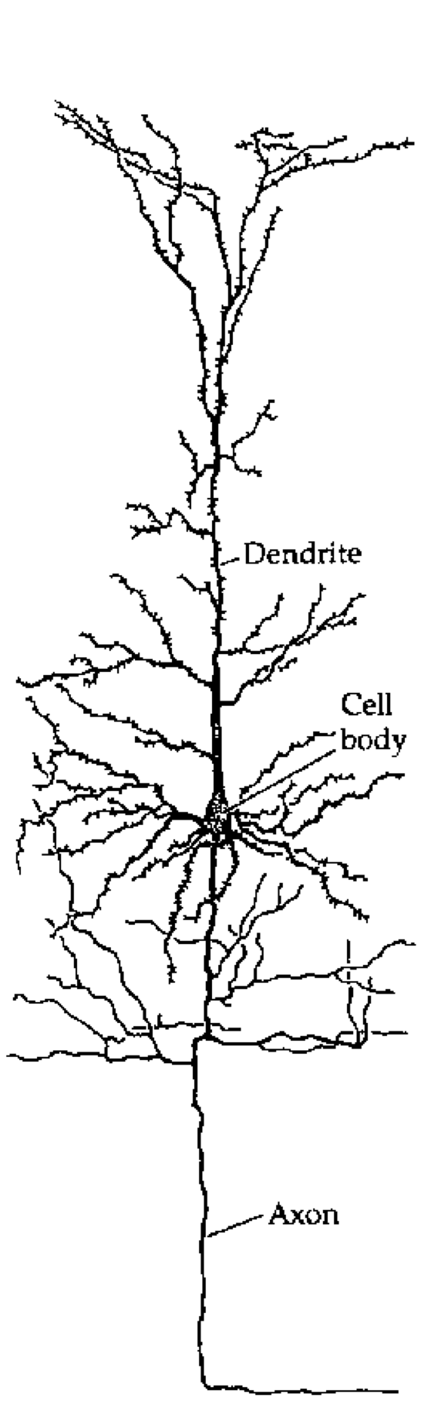
The Basic Unit of Cognition!?

Slide 6
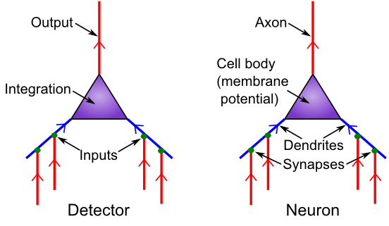
Detector Model
Is it really all just detection?

Slide 7
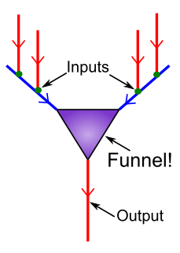
Neurons Compress 10,000 -> 1

Slide 8
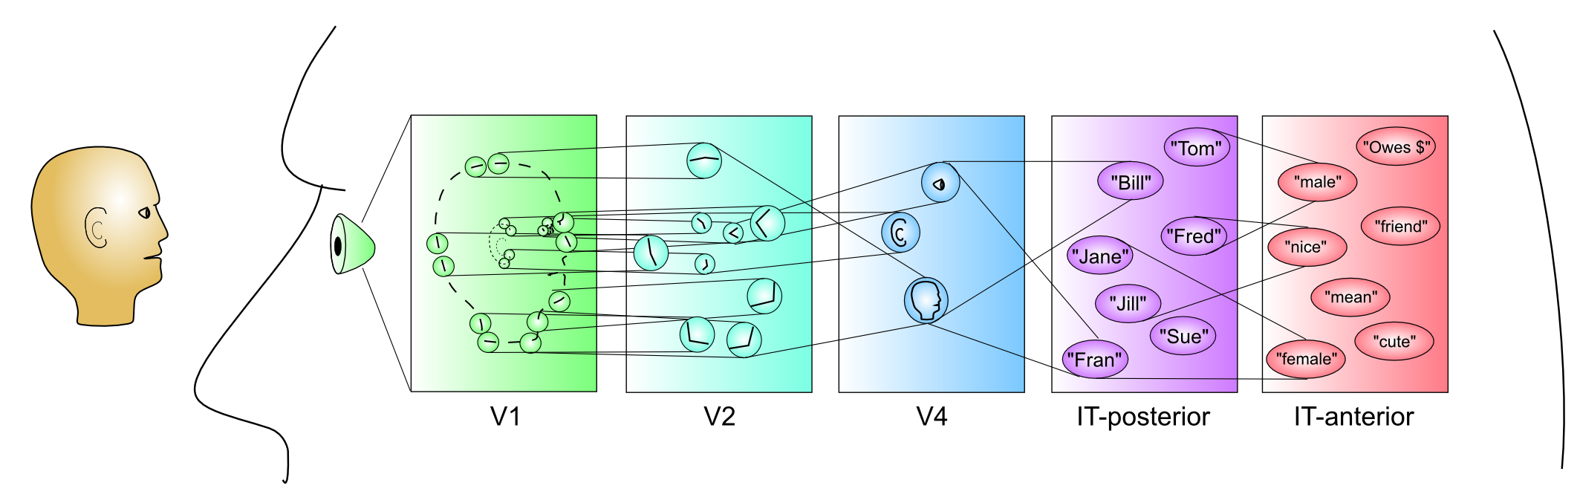
Hierarchy of Detectors (Compression: abstract, simplify)
Inferior Temporal (IT) cortex has high-level abstractions that are relevant to your life!
It takes a village of neurons to build up these abstractions.

Slide 9
Detection = Dimension
Detection = extracting relevant dimension from input: emotion detector, gender detector

Slide 10
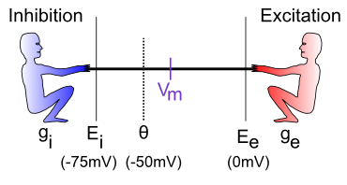
The Tug-of-War
How strongly each guy pulls: I = g (E-Vm) = current
g = how many input channels are open
E = driving potential (pull down for inhibition, up for excitation)
Vm = the “flag” – reflects net balance between two sides

Slide 11
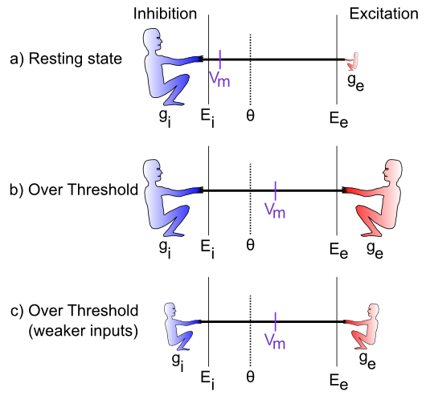
The Tug-of-War (Contrast: Excitation relative to Inhibition)

Slide 12
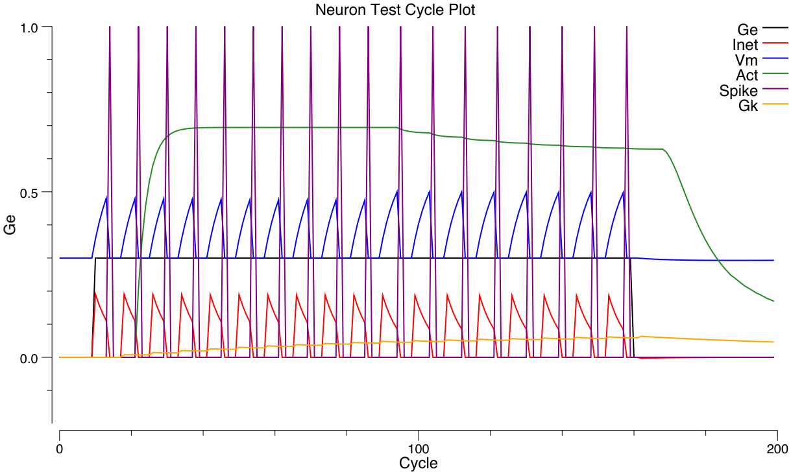
Spiking Output
If Vm gets over threshold, neuron fires a spike.
Spike resets membrane potential back to rest.
Has to climb back up to threshold to spike again

Slide 13
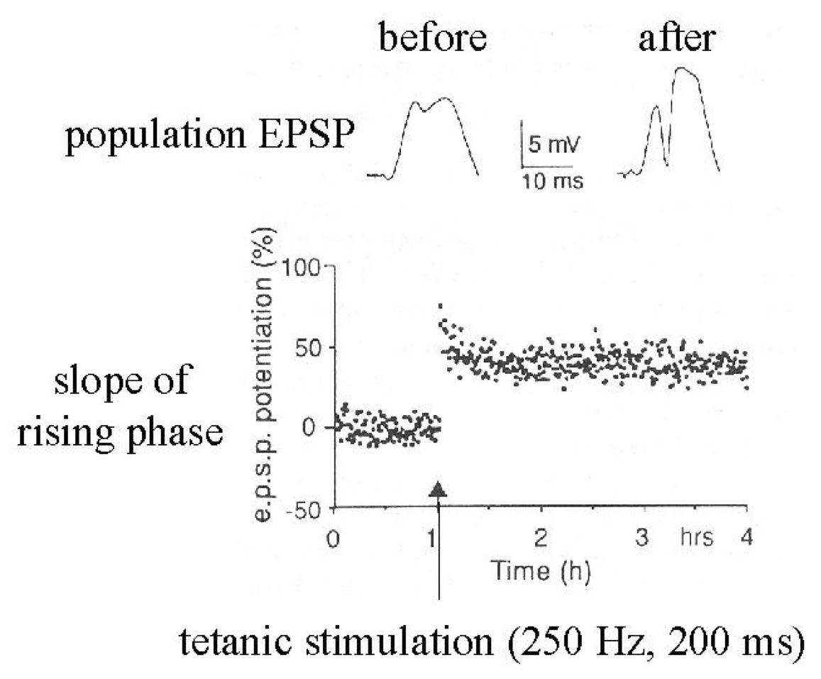
Synapses Change Strength (in response to patterns of activity)

Slide 14
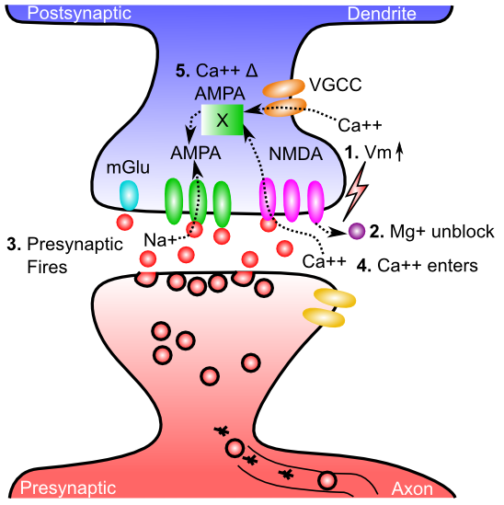
Gettin’ AMPA’d

Slide 15
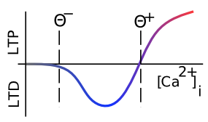
Which Way?

Slide 16
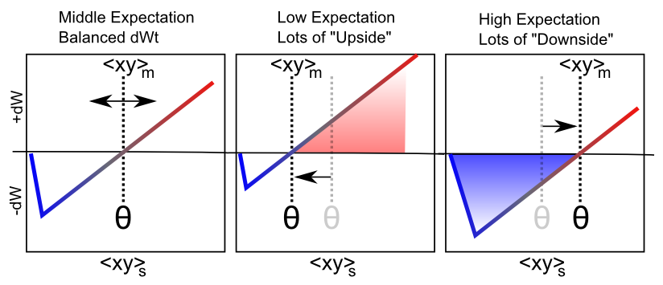
Floating Threshold = Medium Term Synaptic Activity (Error-Driven)
dW = Outcome – Expectation = <xy>_{s} - <xy>_{m}

Slide 17
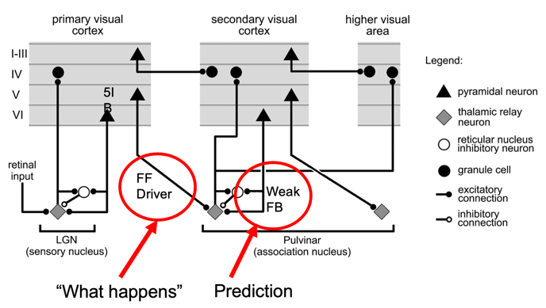
Deep predictive learning (O’Reilly et al, 2021)
Pulvinar receives from all over visual cortex
and projects back out to these same areas
Two inputs:
1. Few strong feedforward:
“what happens”
2. Many weaker feedback:
prediction
Pulvinar!
(Sherman & Guillery, 2006)

Slide 18
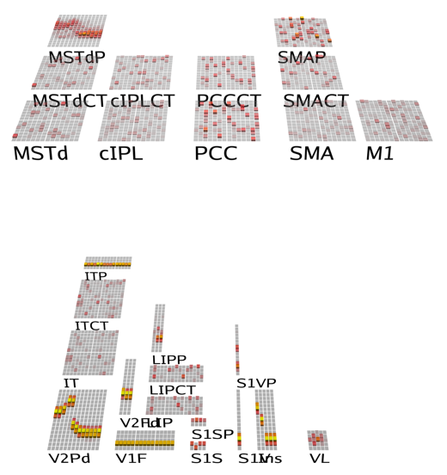
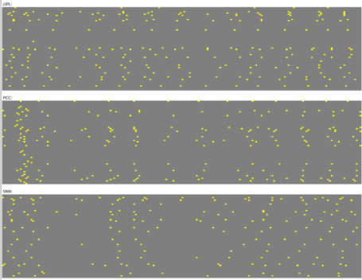
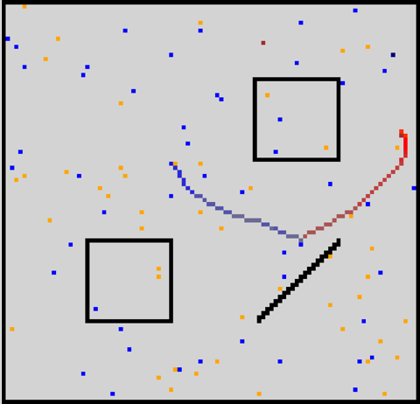
Spiking Predictive Learning Model
Multimodal sensory prediction: full field depth, foveal vision, somatosensory (whiskers, vestibular), body state (thirst, hunger)
Error-driven predictive learning based on action: predict next state
New fully spiking error-driven learning (bio backprop) model!

Slide 19
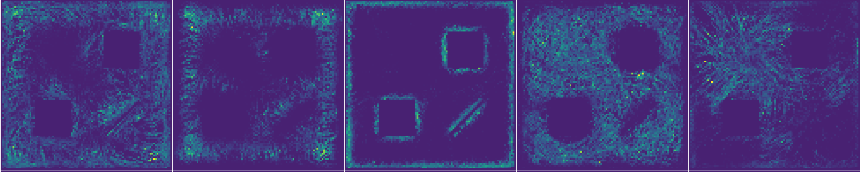
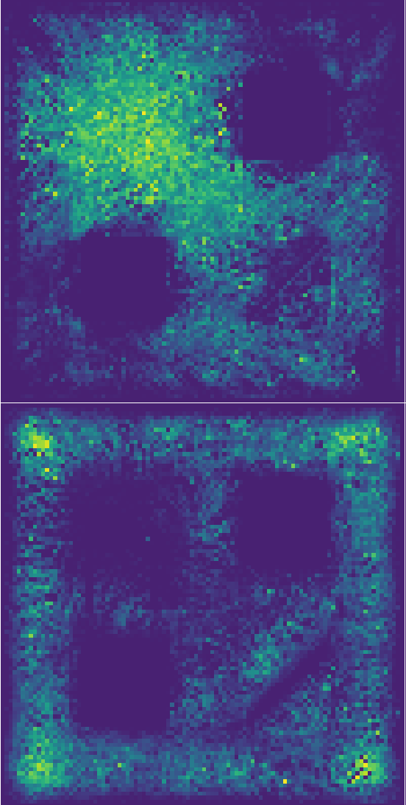
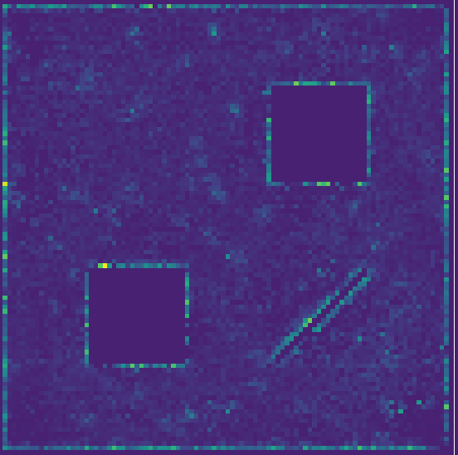
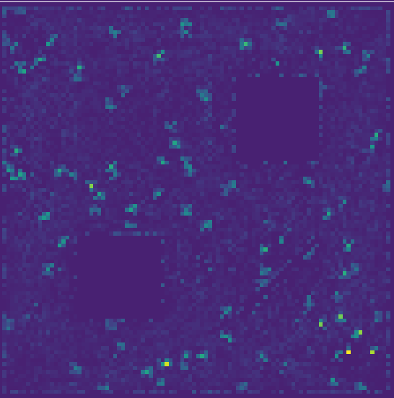
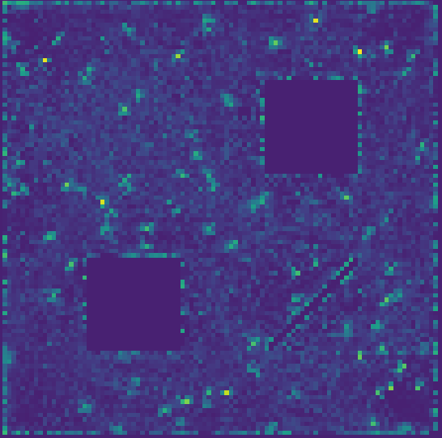
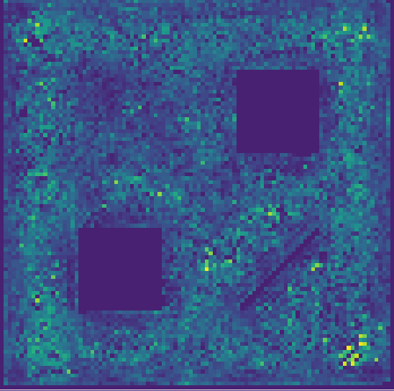
Computational Model Results
MST
PCC
SMA
Clear progression from MST to PCC to SMA: visual flow, borders to more action modulated (consuming spots).
Provides rich tapestry of representational bases for behavior.

Slide 20
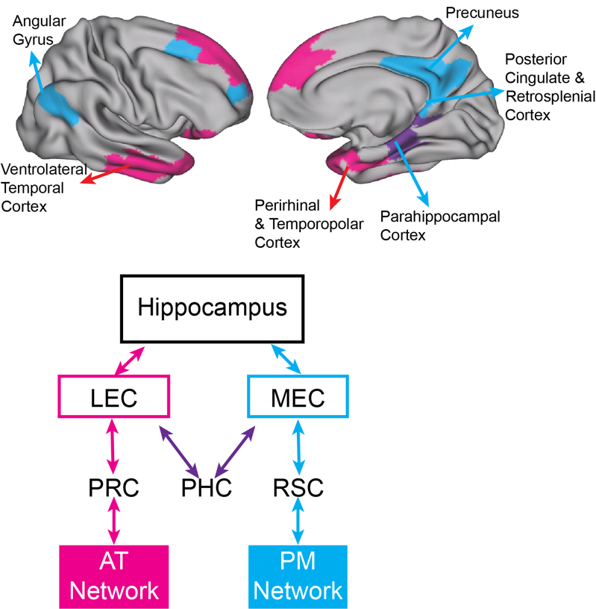
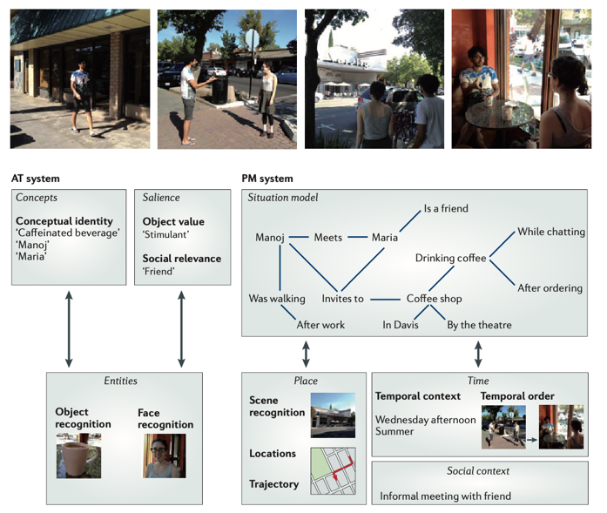
PM / AT Networks (Ranganath)
Fodor & Pylyshyn (1988): Structure sensitive processing is key for systematicity
O’Reilly, Russin, & Ranganath (submitted)
Ranganath & Ritchey, NRN (2012)

Slide 21
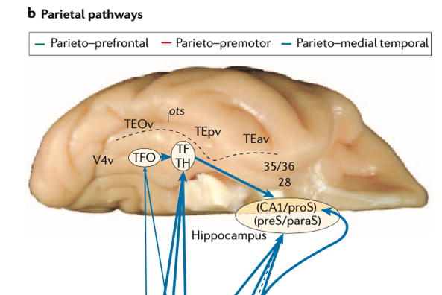
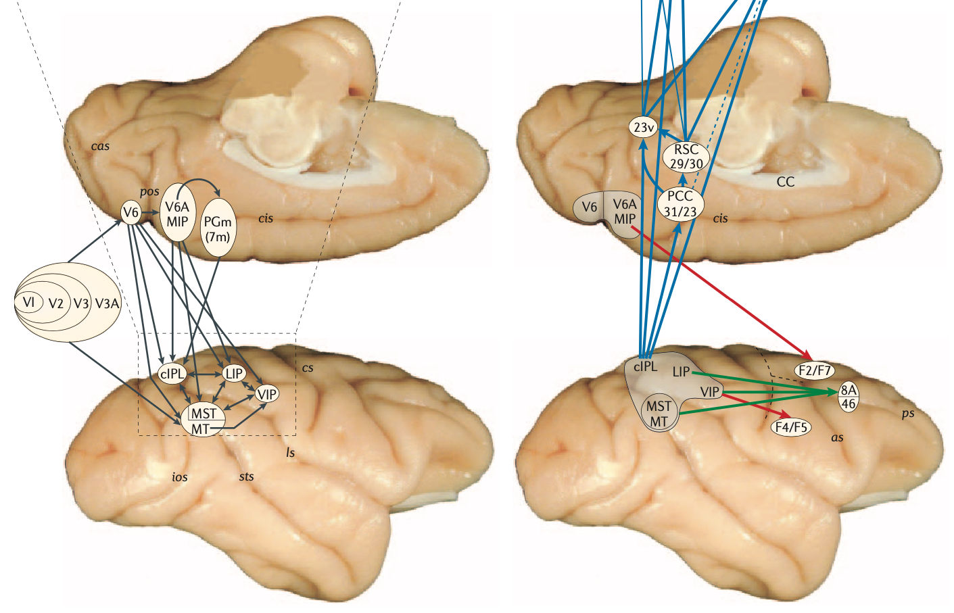
Three Parietal Pathways (Kravitz et al, 2011)
Looking (parieto-prefrontal)
Reaching (parieto-premotor)
Navigating (parieto-medial)

Slide 22
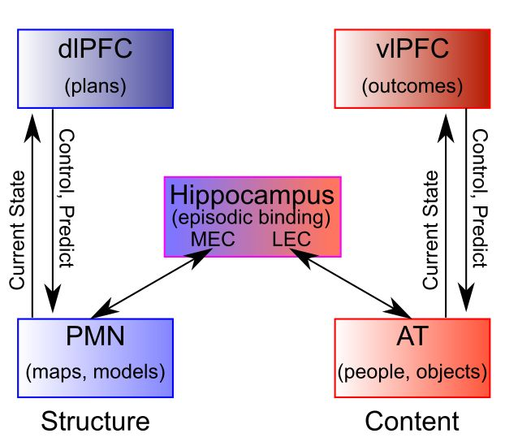
Structure / Content Cognitive Arch
Parietal = links of relational / structural graph
Temporal = nodes w/ content
Highly dynamic, interactive architecture where structure / content paths coordinate to encode overall situation model. But separation = systematicity and generativity.

